Slide 1
PLACEMENT PREDCTION BY USING SVM ALGO
22MIS1044-KOUSHIK
22MIS1049-NAVANEETH
22MIS1171-OMKAR

Slide 2
PROPOSED WORK :
• Support Vector Machine Algorithm
• Support Vector Machine or SVM is one of the most popular Supervised Learning algorithms, which is used for Classification as well as Regression problems. However, primarily, it is used for Classification problems in Machine Learning.
• The goal of the SVM algorithm is to create the best line or decision boundary that can segregate n-dimensional space into classes so that we can easily put the new data point in the correct category in the future. This best decision boundary is called a hyperplane.
• SVM chooses the extreme points/vectors that help in creating the hyperplane. These extreme cases are called as support vectors, and hence algorithm is termed as Support Vector Machine.

Slide 3
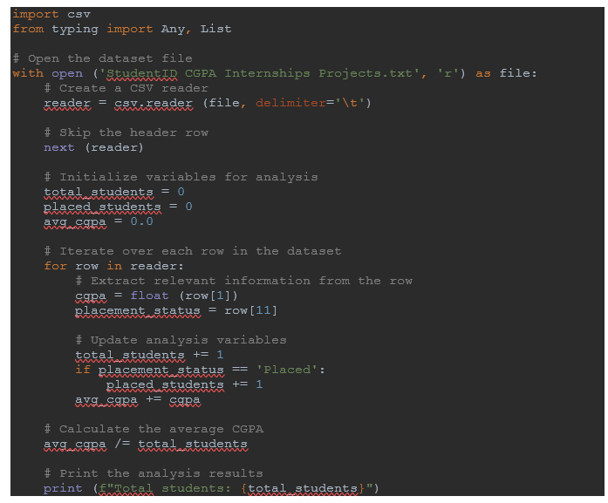
CODES:

Slide 4
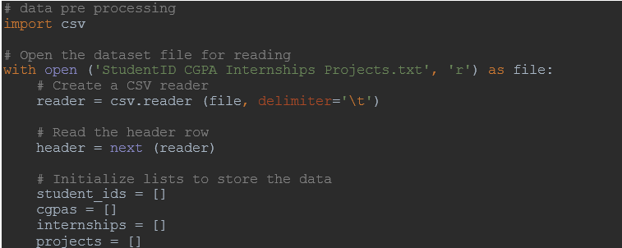

Slide 5
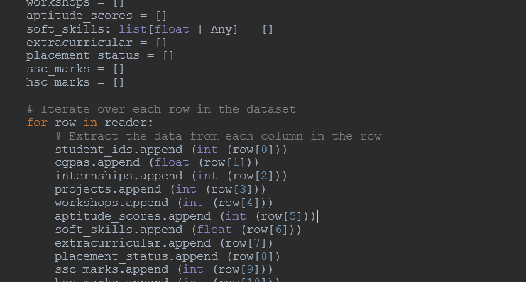
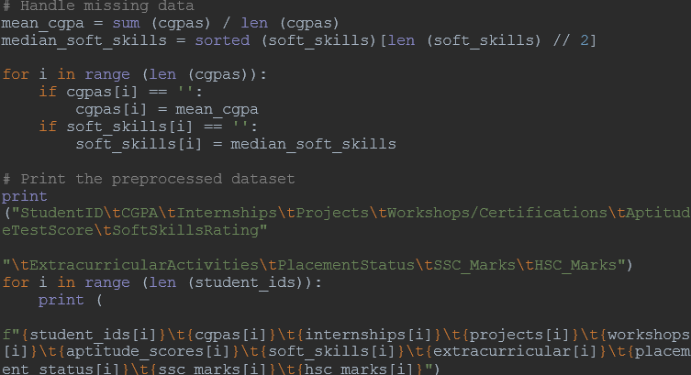

Slide 6
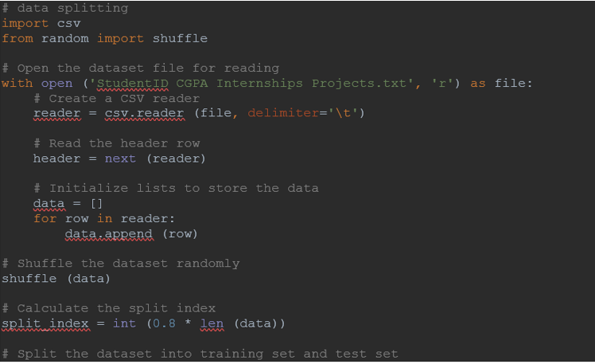
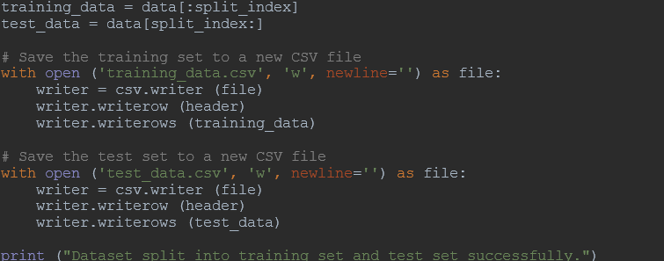

Slide 7
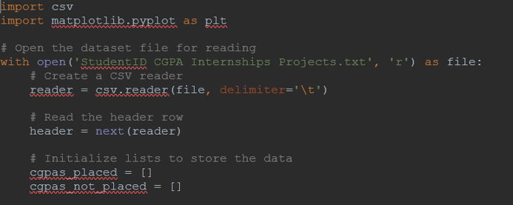
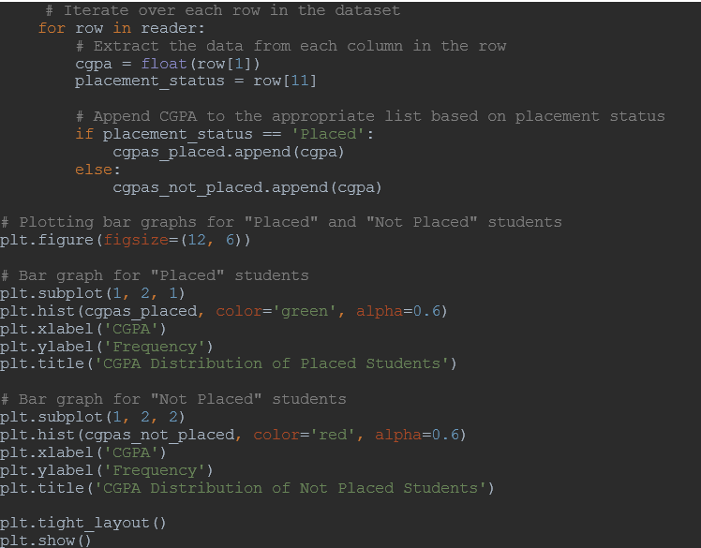

Slide 8
